Slide 1
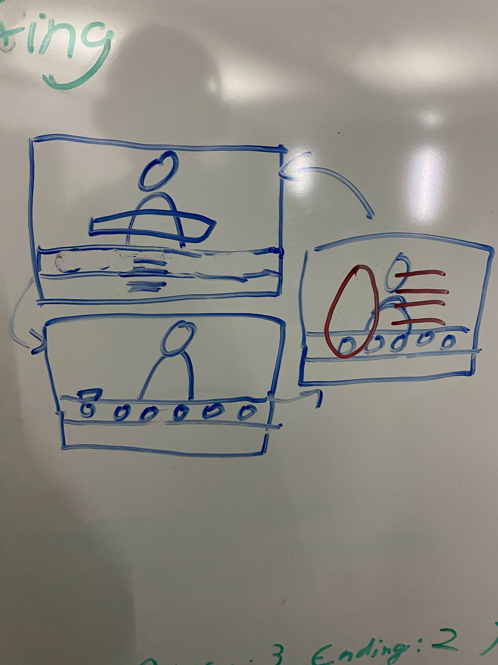

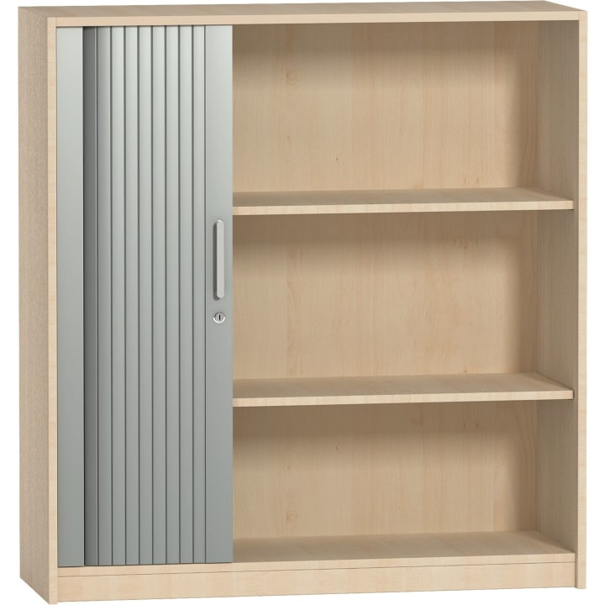

LOCATION NAME: (Player’s Starting point) LOCATION DESCRIPTION: (Name of the location)
LOCATION THEMATIC & APPEARANCE
Describe the thematic idea
LOCATION FUNCTION IN THE WORLD
Describe how it is used in your game/Experience
Douglas Monument Park
Eighth Regiment Armory
BACKSTORY (in TCTD lore)
Describe what it´s backstory is
Community Sign
Unity Hall
Important NPCs (enemies, neutral, allies)
Charakter 1 Charakter 2 Charakter Maske Sad Maske happy Maske Angry Maske Supries Maske Disgust Makse Fear
KEY SITES IN MISSION LOCATION
Mainscreen(Charaktere Tauchen auf) Desk(Dialogue Choices; Schublade für Masken) Schublade Masken(Auswahl Masken, Dialogue Choices Masken)
LEVEL ART IMPORTANT DETAILS
Describe your Points of interest Describe the go to go live roughly
GAMEPLAY USAGE
Es ist das gesamte Spiel lol

